Slide 1
Astronomical Coordinates and the Pluto Lab
ASTR 257

Slide 2
RA and Dec
Like latitude and longitude, but for the celestial sphere
Stays fixed while Earth rotates
RA is typically given in hours (24 total), subdivided into minutes and seconds
Dec is typically given in degrees, subdivided into arcminutes and arcseconds.
On March 21, the Sun is at 0 hours RA and the N-S line overhead at midnight is 12 hours RA
On September 21, the Sun is at 12 hours RA and the N-S line overhead at midnight is 0 hours RA

Slide 3
Precession
In addition to rotating, the Earth’s North pole wobbles around like a top on a 26000 year period. This is called precession.
Because the North pole points at different stars as a function of time, you need to specify a coordinate date. Generally, astronomers use the direction of the Earth on Jan 1, 2000. This is called equinox 2000
As long as you tell the telescope that you’re using equinox 2000 coordinates, it will handle all of the math.
Note: Epoch is the position of a star on a particular date. Equinox is the position of the coordinate system.

Slide 4
The Ecliptic
The ecliptic is the plane with all of the Solar System planets
It is not parallel to our equator (and 0 degrees Dec) because the Earth is tilted

Slide 5
The Galactic Plane

Slide 6
Time
Astronomers tend to use Universal Time (UT or UTC), which is the same as Greenwich England time, but without daylight savings. When you start observing in California, it is already the next day in England. So this evening’s UT date is September 23.
Local Sidereal Time (LST) is the RA of the line connecting North to South directly above wherever you are standing. At the telescope, if you want to know what is directly overhead, look at the LST clock.

Slide 7
Quiz
Order of magnitude, based on what I’ve told you in this lecture, what is LST right now?
What is the RA/Dec Directly Overhead right now?

Slide 8
Julian Dates
Numerical / decimal date system that is easy for computers
Today is Julian date 2458749.0
Day 1 was Jan 1, 4713 BC.

Slide 9
Airmass

Slide 10
Distances Between Objects vs. RA/Dec
Distances between objects are measured in degrees, arcminutes, arcseconds
RA/Dec is measured in hours/degrees, minutes, seconds.
THEY ARE NOT THE SAME!!
Questions:
-How many physical arcseconds are in 1 second of RA at the equator?
-How many physical arcseconds are in 1 second of RA at 60 degrees declination?

Slide 11
Summary
Astronomical coordinates are boring and a pain in the ass.
For the most part, astropy and online websites can do all of it for you, but you have to be on the lookout for weird subtleties like RA seconds vs. arcseconds and epoch vs. equinox.
In real time at the telescope, airmass and LST are particularly important to understand.

Slide 12
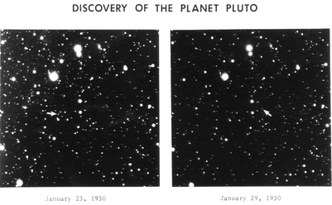
Pluto
Use the Nickel telescope to measure Pluto’s motion compared to background stars over two nights
The Pluto handout takes you through step-by-step.
Plan observations and present your detailed plan to Andy/X between 3-4.
Do daytime calibrations around 4.
Nighttime observations around 8.

